Slide 1
Defining a Column Alias
  Renames a column heading
  Is useful with calculations
  Immediately follows column name;
  AS keyword between column name and alias
Notes:
Column Aliases
When displaying the result of a query, SQL*Plus normally uses the name of the selected column as the column heading. In many cases, this heading may not be descriptive and hence is difficult to understand. You can change a column heading by using a column alias.
Specify the alias after the column in the SELECT list using a space as a separator. By default, alias headings appear in uppercase. If the alias contains spaces, special characters (such as # or $), or is case sensitive, enclose the alias in double quotation marks (" ").
Class Management Note
Within a SQL statement, a column alias can be used in both the SELECT clause and the ORDER BY clause. You cannot use column aliases in the WHERE clause. Both alias features comply with the ANSI SQL 92 standard.
Demo: l1alias.sql
Purpose: To illustrate the use of aliases in expressions.

Slide 2
Using Column Aliases
SQL> SELECT ename AS name, sal AS salary
FROM emp;
NAME SALARY
------------- ---------
...
SQL> SELECT ename Name,
sal*12 AS AnnualSalary
FROM emp;
Name AnnualSalary
------------- -------------
...
Notes:
Column Aliases (continued)
The first example displays the name and the monthly salary of all the employees. Notice that the optional AS keyword has been used before the column alias name. The result of the query would be the same whether the AS keyword is used or not. Also notice that the SQL statement has the column aliases, name and salary, in lowercase, whereas the result of the query displays the column headings in uppercase. As mentioned in the last slide, column headings appear in uppercase by default.
The second example displays the name and annual salary of all the employees. Because Annual Salary contains spaces, it has been enclosed in double quotation marks. Notice that the column heading in the output is exactly the same as the column alias.
Class Management Note
Point out the optional AS keyword in the first example and the double quotation marks in the second example. Also show that the aliases always appear in uppercase, unless enclosed within double quotation marks.

Slide 3
Using the LIKE Operator
  Use the LIKE operator to perform wildcard searches of valid search string values.
  Search conditions can contain either literal characters or numbers.
    % denotes zero or many characters.
    _ denotes one character.
SQL> SELECT ename
2 FROM emp
3 WHERE ename LIKE 'S%';
Notes:
The LIKE Operator
You may not always know the exact value to search for. You can select rows that match a character pattern by using the LIKE operator. The character pattern-matching operation is referred to as a wildcard search. Two symbols can be used to construct the search string.
The SELECT statement above returns the employee name from the EMP table for any employee whose name begins with an “S.” Note the uppercase “S.” Names beginning with an “s” will not be returned.
The LIKE operator can be used as a shortcut for some BETWEEN comparisons. The following example displays names and hire dates of all employees who joined between January 1981 and December 1981:
SQL> SELECT ename, hiredate
2 FROM emp
3 WHERE hiredate LIKE '%81';

Slide 4
Using the LIKE Operator
  You can combine pattern-matching characters.
SQL> SELECT ename
2 FROM emp
3 WHERE ename LIKE '_A%';
ENAME
----------
MARTIN
JAMES
WARD
Notes:
Combining Wildcard Characters
The % and _ symbols can be used in any combination with literal characters. The example on the slide displays the names of all employees whose name has an “A” as the second character.
The ESCAPE Option
When you need to have an exact match for the actual ‘%’ and ‘_’ characters, use the ESCAPE option. This option specifies what the ESCAPE character is. To display the names of employees whose name contains ‘A_B’, use the following SQL statement:
The ESCAPE option identifies the backslash (\) as the escape character. In the pattern, the escape character precedes the underscore (_). This causes the Oracle Server to interpret the underscore literally.
SQL> SELECT ename
2 FROM emp
3 WHERE ename LIKE '%A\_B%' ESCAPE '\';

Slide 5
Using the IS NULL Operator
Test for null values with the IS NULL operator.
SQL> SELECT ename, mgr
2 FROM emp
3 WHERE mgr IS NULL;
ENAME MGR
---------- ---------
KING
Notes:
The IS NULL Operator
The IS NULL operator tests for values that are null. A null value means the value is unavailable, unassigned, unknown, or inapplicable. Therefore, you cannot test with (=) because a null value cannot be equal or unequal to any value. The slide example retrieves the name and manager of all employees who do not have a manager.
For example, to display name, job title, and commission for all employees who are not entitled to get a commission, use the following SQL statement:
ENAME JOB COMM
-------- ----------- ------
KING PRESIDENT
BLAKE MANAGER
CLARK MANAGER
...

Slide 6
Logical Operators
Operator
AND
OR
NOT
Meaning
Returns TRUE if both component conditions are TRUE
Returns TRUE if either component condition is TRUE
Returns TRUE if the following condition is FALSE
Notes:
Logical Operators
A logical operator combines the result of two component conditions to produce a single result based on them or to invert the result of a single condition. Three logical operators are available in SQL:
AND
OR
NOT
All the examples so far have specified only one condition in the WHERE clause. You can use several conditions in one WHERE clause using the AND and OR operators.

Slide 7
Using the AND Operator
AND requires both conditions to be TRUE.
SQL> SELECT empno, ename, job, sal
2 FROM emp
3 WHERE sal>=1100
4 AND job='CLERK';
EMPNO ENAME JOB SAL
--------- ---------- --------- ---------
7876 ADAMS CLERK 1100
7934 MILLER CLERK 1300
Notes:
The AND Operator
In the example, both conditions must be true for any record to be selected. Therefore, an employee who has a job title of CLERK and earns more than $1100 will be selected.
All character searches are case sensitive. No rows are returned if CLERK is not in uppercase. Character strings must be enclosed in quotation marks.
AND Truth Table
The following table shows the results of combining two expressions with AND:
Class Management Note
Demo: l2and.sql
Purpose: To illustrate using the AND operator.

Slide 8
Using the OR Operator
  OR requires either condition to be TRUE.
SQL> SELECT empno, ename, job, sal
2 FROM emp
3 WHERE sal>=1100
4 OR job='CLERK';
EMPNO ENAME JOB SAL
--------- ---------- --------- ---------
7839 KING PRESIDENT 5000
7698 BLAKE MANAGER 2850
7782 CLARK MANAGER 2450
7566 JONES MANAGER 2975
7654 MARTIN SALESMAN 1250
...
7900 JAMES CLERK 950
...
14 rows selected.
Notes:
The OR Operator
In the example, either condition can be true for any record to be selected. Therefore, an employee who has a job title of CLERK or earns more than $1100 will be selected.
The OR Truth Table
The following table shows the results of combining two expressions with OR:
Class Management Note
Demo: l2or.sql
Purpose: To illustrate using the OR operator.

Slide 9
Using the NOT Operator
SQL> SELECT ename, job
2 FROM emp
3 WHERE job NOT IN ('CLERK','MANAGER','ANALYST');
ENAME JOB
---------- ---------
KING PRESIDENT
MARTIN SALESMAN
ALLEN SALESMAN
TURNER SALESMAN
WARD SALESMAN
Notes:
The NOT Operator
The slide example displays name and job title of all the employees whose job title is not CLERK, MANAGER, or ANALYST.
The NOT Truth Table
The following table shows the result of applying the NOT operator to a condition:
Note: The NOT operator can also be used with other SQL operators, such as BETWEEN, LIKE, and NULL.
... WHERE NOT job IN ('CLERK', 'ANALYST')
... WHERE sal NOT BETWEEN 1000 AND 1500
... WHERE ename NOT LIKE '%A%'
... WHERE comm IS NOT NULL

Slide 10
Sorting Data
  Sort rows with the ORDER BY clause
    ASC: ascending order, default
    DESC: descending order
  The ORDER BY clause comes last in the SELECT statement.
SQL> SELECT ename, job, deptno, hiredate
2 FROM emp
3 ORDER BY hiredate;
ENAME JOB DEPTNO HIREDATE
---------- --------- --------- ---------
SMITH CLERK 20 17-DEC-80
ALLEN SALESMAN 30 20-FEB-81
...
14 rows selected.
Notes:
The ORDER BY Clause
The order of rows returned in a query result is undefined. The ORDER BY clause can be used to sort the rows. If you use the ORDER BY clause, you must place last. You can specify an expression or an alias to sort.
Syntax
SELECT expr
FROM table
[WHERE condition(s)]
[ORDER BY {column, expr} [ASC|DESC]];
where: ORDER BY specifies the order in which the retrieved rows are displayed
ASC orders the rows in ascending order (this is the default order)
DESC orders the rows in descending order
If the ORDER BY clause is not used, the sort order is undefined, and the Oracle Server may not fetch rows in the same order for the same query twice. Use the ORDER BY clause to display the rows in a specific order.

Slide 11
Sorting in Descending Order
SQL> SELECT ename, job, deptno, hiredate
2 FROM emp
3 ORDER BY hiredate DESC;
ENAME JOB DEPTNO HIREDATE
---------- --------- --------- ---------
ADAMS CLERK 20 12-JAN-83
SCOTT ANALYST 20 09-DEC-82
MILLER CLERK 10 23-JAN-82
JAMES CLERK 30 03-DEC-81
FORD ANALYST 20 03-DEC-81
KING PRESIDENT 10 17-NOV-81
MARTIN SALESMAN 30 28-SEP-81
...
14 rows selected.
Notes:
Default Ordering of Data
The default sort order is ascending:
Numeric values are displayed with the lowest values first—for example, 1–999.
Date values are displayed with the earliest value first—for example, 01-JAN-92 before
01-JAN-95.
Character values are displayed in alphabetical order—for example, A first and Z last.
Null values are displayed last for ascending sequences and first for descending sequences.
Reversing the Default Order
To reverse the order in which rows are displayed, specify the keyword DESC after the column name in the ORDER BY clause. The slide example sorts the result by the most recently hired employee.

Slide 12
Sorting by Column Alias
SQL> SELECT empno, ename, sal*12 annsal
2 FROM emp
3 ORDER BY annsal;
EMPNO ENAME ANNSAL
--------- ---------- ---------
7369 SMITH 9600
7900 JAMES 11400
7876 ADAMS 13200
7654 MARTIN 15000
7521 WARD 15000
7934 MILLER 15600
7844 TURNER 18000
...
14 rows selected.
Notes:
Sorting By Column Aliases
You can use a column alias in the ORDER BY clause. The slide example sorts the data by annual salary.

Slide 13
Obtaining Data from Multiple Tables
EMP
DEPT
EMPNO ENAME ... DEPTNO
------ ----- ... ------
7839 KING ... 10
7698 BLAKE ... 30
...
7934 MILLER ... 10
DEPTNO DNAME LOC
------ ---------- --------
10 ACCOUNTING NEW YORK
20 RESEARCH DALLAS
30 SALES CHICAGO
40 OPERATIONS BOSTON
EMPNO DEPTNO LOC
----- ------- --------
7839 10 NEW YORK
7698 30 CHICAGO
7782 10 NEW YORK
7566 20 DALLAS
7654 30 CHICAGO
7499 30 CHICAGO
...
14 rows selected.
Notes:
Data from Multiple Tables
Sometimes you need to use data from more than one table. In the slide example, the report displays data from two separate tables.
EMPNO exists in the EMP table.
DEPTNO exists in both the EMP and DEPT the tables.
LOC exists in the DEPT table.
To produce the report, you need to link EMP and DEPT tables and access data from both of them.
Class Management Note
In the slide, the DEPTNO column can come from either the EMP or the DEPT table.

Slide 14
What Is a Join?
Use a join to query data from more than one table.
  Write the join condition in the WHERE clause.
  Prefix the column name with the table name when the same column name appears in more than one table.
SELECT table1.column, table2.column
FROM table1, table2
WHERE table1.column1 = table2.column2;
Notes:
Defining Joins
When data from more than one table in the database is required, a join condition is used. Rows in one table can be joined to rows in another table according to common values existing in corresponding columns, that is, usually primary and foreign key columns.
To display data from two or more related tables, write a simple join condition in the WHERE clause. In the syntax:
table1.column denotes the table and column from which data is retrieved
table1.column1 = is the condition that joins (or relates) the tables together
table2.column2
Guidelines
When writing a SELECT statement that joins tables, precede the column name with the table name for clarity and to enhance database access.
If the same column name appears in more than one table, the column name must be prefixed with the table name.
To join n tables together, you need a minimum of (n-1) join conditions. Therefore, to join four tables, a minimum of three joins are required. This rule may not apply if your table has a concatenated primary key, in which case more than one column is required to uniquely identify each row.
For more information, see
Oracle Server SQL Reference Manual, Release 8, “SELECT.”

Slide 15
Generating a Cartesian Product
EMP (14 rows)
DEPT (4 rows)
EMPNO ENAME ... DEPTNO
------ ----- ... ------
7839 KING ... 10
7698 BLAKE ... 30
...
7934 MILLER ... 10
DEPTNO DNAME LOC
------ ---------- --------
10 ACCOUNTING NEW YORK
20 RESEARCH DALLAS
30 SALES CHICAGO
40 OPERATIONS BOSTON
ENAME DNAME
------ ----------
KING ACCOUNTING
BLAKE ACCOUNTING
...
KING RESEARCH
BLAKE RESEARCH
...
56 rows selected.
SELECT *
FROM emp,dept;
“Cartesian
product:
14*4=56 rows”
Omit join condition in where clause and get Cartesian product
Notes:
Cartesian Product (continued)
A Cartesian product is generated if a join condition is omitted. The example on the slide displays employee name and department name from EMP and DEPT tables. Because no WHERE clause has been specified, all rows (14 rows) from the EMP table are joined with all rows (4 rows) in the DEPT table, thereby generating 56 rows in the output.
Class Management Note
Demo: l4cart.sql
Purpose: To illustrate executing a Cartesian product.
SQL> SELECT ename, dname
2 FROM emp, dept;
ENAME DNAME
---------- --------------
KING ACCOUNTING
BLAKE ACCOUNTING
...
KING RESEARCH
BLAKE RESEARCH
...
56 rows selected.

Slide 16
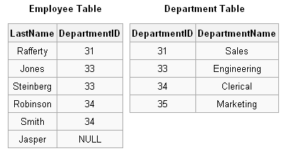
Sample Tables

Slide 17
INNER JOIN
Combines records from two tables whenever there are matching values in a common field.
Syntax
FROM table1 INNER JOIN table2 ON table1.field1 compopr table2.field2
table1 and table2 are names of two tables
compopr is the comparision operator
field1 and field2 are names of join fields

Slide 18
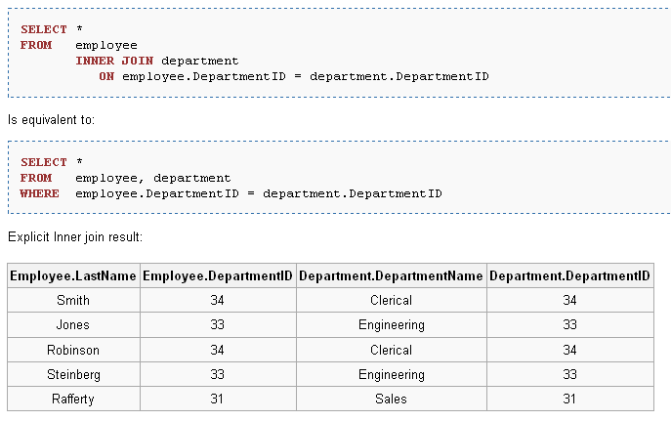
INNER JOIN EXAMPLE

Slide 19
LEFT OUTER JOIN
  In outer join all records from left side table in LEFT JOIN operation are added to the resulting relation, even if there are no matching values in the joined field from the table on the right.
  Records from the table on the right are combined with those from the table on the left only when there are matching values in the joined fields. When a left-side record has no match, a row of Null values is joined on the right side.

Slide 20
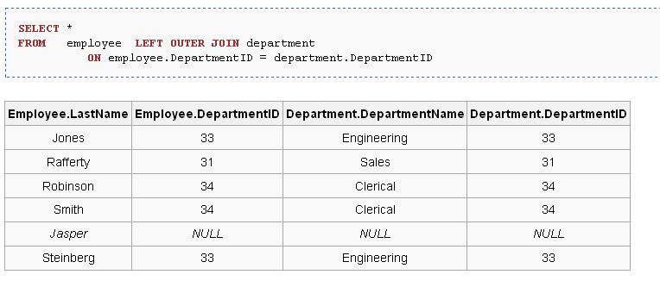
Outer Join (Left)

Slide 21
RIGHT OUTER JOIN
  In outer join all records from right side table in RIGHT JOIN operation are added to the resulting relation, even if there are no matching values in the joined field from the table on the left.
  Records from the table on the left are combined with those from the table on the right only when there are matching values in the joined fields. When a right-side record has no match, a row of Null values is joined on the left side.

Slide 22
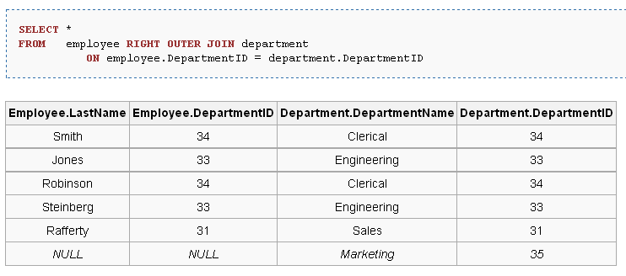
Outer Join (Right)

Slide 23
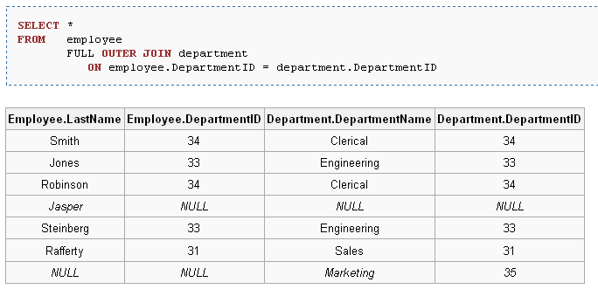
Full Outer Join

Slide 24
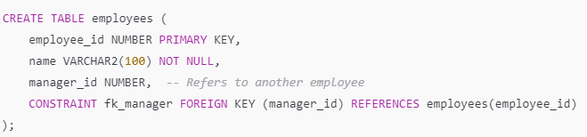
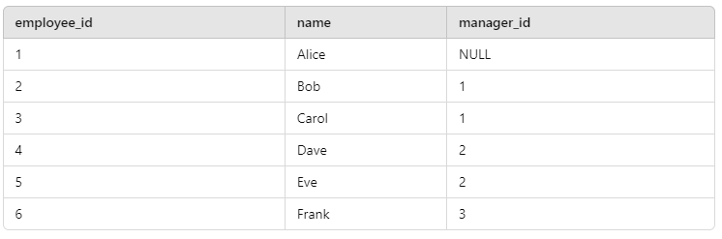
Self Join

Slide 25
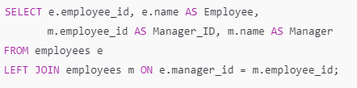
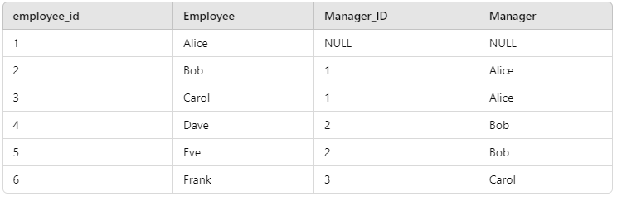
Self Join

Slide 26
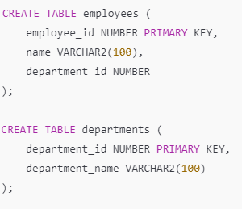
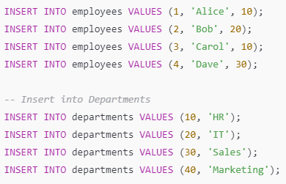

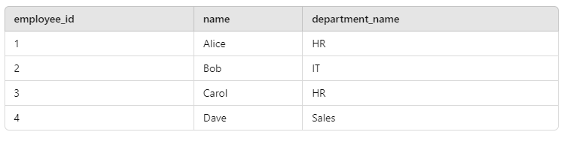
Natural Join
Both tables have department_id (Common column).
Oracle automatically joins them using department_id in a NATURAL JOIN.
Only matching records are included (like an INNER JOIN).

Slide 27
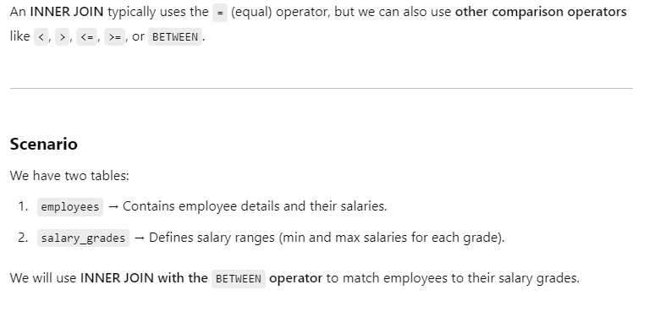
INNER JOIN Without Equal (=) Operator

Slide 28
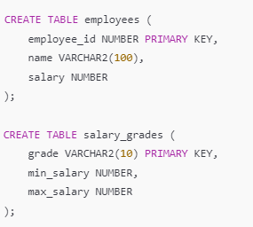
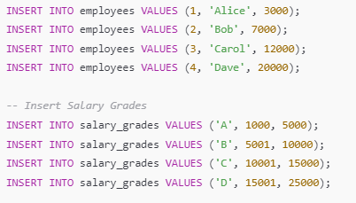
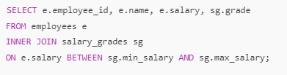
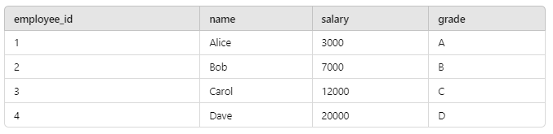
INNER JOIN Without Equal (=) Operator

Slide 29
Aggregations
SUM, AVG, COUNT, MIN, and MAX can be applied to a column in a SELECT clause to produce that aggregation on the column.
Also, COUNT(*) counts the number of tuples.

Slide 30
Types of Group Functions
  AVG
  COUNT
  MAX
  MIN
  STDDEV
  SUM
  VARIANCE
Notes:
Group Functions (continued)
Each of the functions accepts an argument. The following table identifies the options that you can use in the syntax:

Slide 31
Using AVG and SUM Functions
You can use AVG and SUM for numeric data.
SQL> SELECT AVG(sal), MAX(sal),
2 MIN(sal), SUM(sal)
3 FROM emp
4 WHERE job LIKE 'SALES%';
AVG(SAL) MAX(SAL) MIN(SAL) SUM(SAL)
-------- --------- --------- ---------
1400 1600 1250 5600
Notes:
Group Functions
You can use AVG, SUM, MIN, and MAX functions against columns that can store numeric data. The example on the slide displays the average, highest, lowest, and sum of monthly salaries for all salespeople.

Slide 32
Using MIN and MAX Functions
You can use MIN and MAX for any datatype.
SQL> SELECT MIN(hiredate), MAX(hiredate)
2 FROM emp;
MIN(HIRED MAX(HIRED
--------- ---------
17-DEC-80 12-JAN-83
Notes:
Group Functions (continued)
You can use MAX and MIN functions for any datatype. The slide example displays the most junior and most senior employee.
The following example displays the employee name that is first and the employee name that is the last in an alphabetized list of all employees.
Note: AVG, SUM, VARIANCE, and STDDEV functions can be used only with numeric datatypes.
SQL> SELECT MIN(ename), MAX(ename)
2 FROM emp;
MIN(ENAME) MAX(ENAME)
---------- ----------
ADAMS WARD

Slide 33
Using the COUNT Function
COUNT(*) returns the number of rows in a table.
SQL> SELECT COUNT(*)
2 FROM emp
3 WHERE deptno = 30;
COUNT(*)
---------
6
Notes:
The COUNT Function
The COUNT function has two formats:
COUNT(*)
COUNT(expr)
COUNT(*) returns the number of rows in a table, including duplicate rows and rows containing null values in any of the columns. If a WHERE clause is included in the SELECT statement, COUNT(*) returns the number of rows that satisfies the condition in the WHERE clause.
In contrast, COUNT(expr) returns the number of nonnull rows in the column identified by expr.
The slide example displays the number of employees in department 30.
Class Management Note
Demo: l5count1.sql, l5count2.sql
Purpose: To illustrate using the COUNT(*) and COUNT(expr) functions.

Slide 34
Using the COUNT Function
COUNT(expr) returns the number of nonnull rows.
SQL> SELECT COUNT(comm)
2 FROM emp
3 WHERE deptno = 30;
COUNT(COMM)
-----------
4
Notes:
The COUNT Function (continued)
The slide example displays the number of employees in department 30 who can earn a commission. Notice that the result gives the total number of rows to be four because two employees in department 30 cannot earn a commission and contain a null value in the COMM column.
Example
Display the number of departments in the EMP table.
Display the number of distinct departments in the EMP table.
SQL> SELECT COUNT(deptno)
2 FROM emp;
COUNT(DEPTNO)
-------------
14
COUNT(DISTINCT(DEPTNO))
-----------------------
3

Slide 35
Group Functions and Null Values
Group functions ignore null values in the column.
SQL> SELECT AVG(comm)
2 FROM emp;
AVG(COMM)
---------
550
Notes:
Group Functions and Null Values
All group functions except COUNT (*) ignore null values in the column. In the slide example, the average is calculated based only on the rows in the table where a valid value is stored in the COMM column. The average is calculated as total commission being paid to all employees divided by the number of employees receiving commission (4).

Slide 36
Creating Groups of Data
EMP
DEPTNO SAL
--------- ---------
10 2450
10 5000
10 1300
20 800
20 1100
20 3000
20 3000
20 2975
30 1600
30 2850
30 1250
30 950
30 1500
30 1250
2916.6667
“average
salary
in EMP
table
for each
department”
DEPTNO AVG(SAL)
------- ---------
10 2916.6667
20 2175
30 1566.6667
2175
1566.6667

Slide 37
Creating Groups of Data:
GROUP BY Clause
SELECT column, group_function(column)
FROM table
[WHERE condition]
[GROUP BY group_by_expression]
[ORDER BY column];
Divide rows in a table into smaller groups by using the GROUP BY clause.

Slide 38
Using the GROUP BY Clause
All columns in the SELECT list that are not in group functions must be in the GROUP BY clause.
SQL> SELECT deptno, AVG(sal)
2 FROM emp
3 GROUP BY deptno;
DEPTNO AVG(SAL)
--------- ---------
10 2916.6667
20 2175
30 1566.6667

Slide 39
Using the GROUP BY Clause
The GROUP BY column does not have to be in the SELECT list.
SQL> SELECT AVG(sal)
2 FROM emp
3 GROUP BY deptno;
AVG(SAL)
---------
2916.6667
2175
1566.6667
Notes:
DEPTNO AVG(SAL)
---------- ------------
30 1566.6667
20 2175
10 2916.6667

